Slide 1
Skills for Change:
Addressing Health Equity through Relational Organizing
Nathan Kittle MD
TWC - Healthpoint Family Medicine Residency
Luis Manriquez MD
IAF-NW Health Equity Organizing co-director
WSU Elson S Floyd College of Medicine
Brian Park MD MPH
Oregon Health & Science University - Depts of Family & Preventive Med

Slide 2
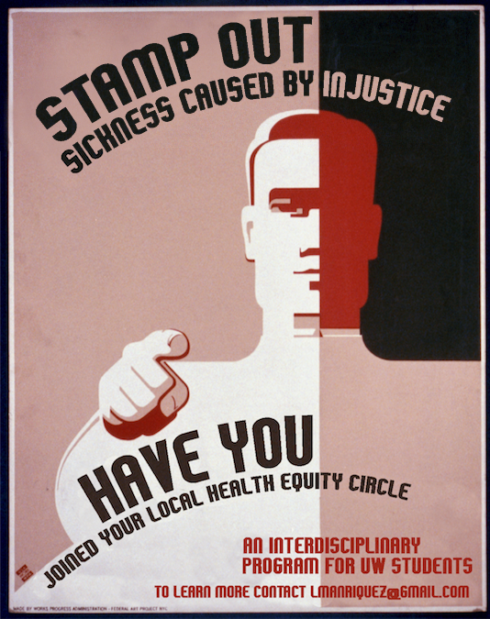
Disclosure
On Education
We believe that ultimate purpose of education is to illuminate science, society and nature as unfinished.
And to prepare the student to bring their training to bear on creation of a more equitable and just world.
Notes:
So I’ve always wondered about why the only disclosures are about potential conflicts of interests or negatives. I’ve always wanted to see disclosures that address where your coming from not just who paid you

Slide 3
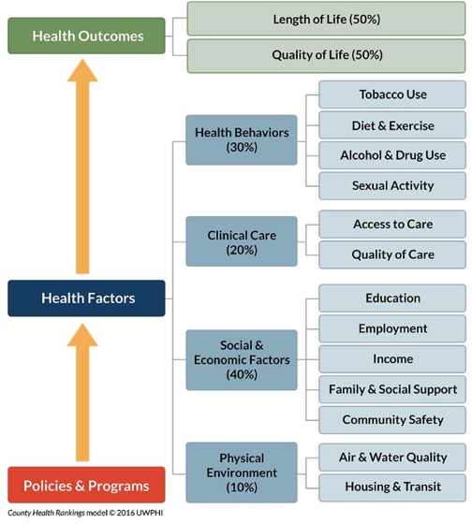
Big picture
1. As a determinant of health, medical care is insufficient for ensuring better health outcomes.
2. How do we intervene without medicalizing SDoH?
3. What (new) data are needed?
Magnan, S. 2017. Social determinants of health 101 for health care: five plus five. NAM Perspectives.
Discussion Paper, National Academy of Medicine, Washington, DC.
https://nam.edu/social-determinants-of-health-101-for-health-care-five-plus-five.

Slide 4
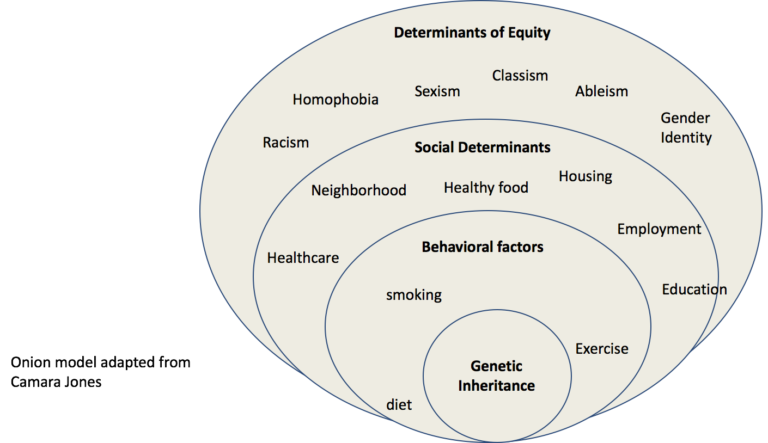
Big picture

Slide 5
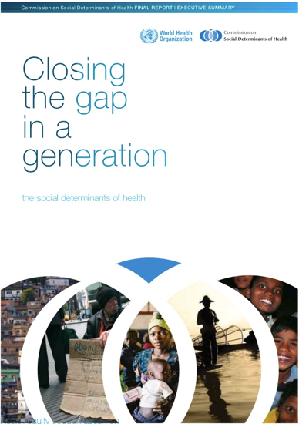
Big picture
1. Improve daily living conditions
2. Tackle the inequitable distribution of power, money, resources
3. Measure and understand the problem and assess the impact of action
Magnan, S. 2017. Social determinants of health 101 for health care: five plus five. NAM Perspectives.
Discussion Paper, National Academy of Medicine, Washington, DC.
https://nam.edu/social-determinants-of-health-101-for-health-care-five-plus-five.

Slide 6
Doctor’s role in Health Equity
If “structural competency is taken to imply that physicians can change politically determined social
determinants of health in the course
of the clinical encounter,
I disagree
Geiger, H. J. (2017). "The Political Future of Social Medicine: Reflections on Physicians as Activists." Acad Med 92(3): 282-284.
Notes:
A pathway for clinicians to work for structural change already exists and requires dramatic expansion.
It involves clinician participation in the work of voluntary nongovernmental organizations (NGOs) and multiprofessional collaborations.

Slide 7
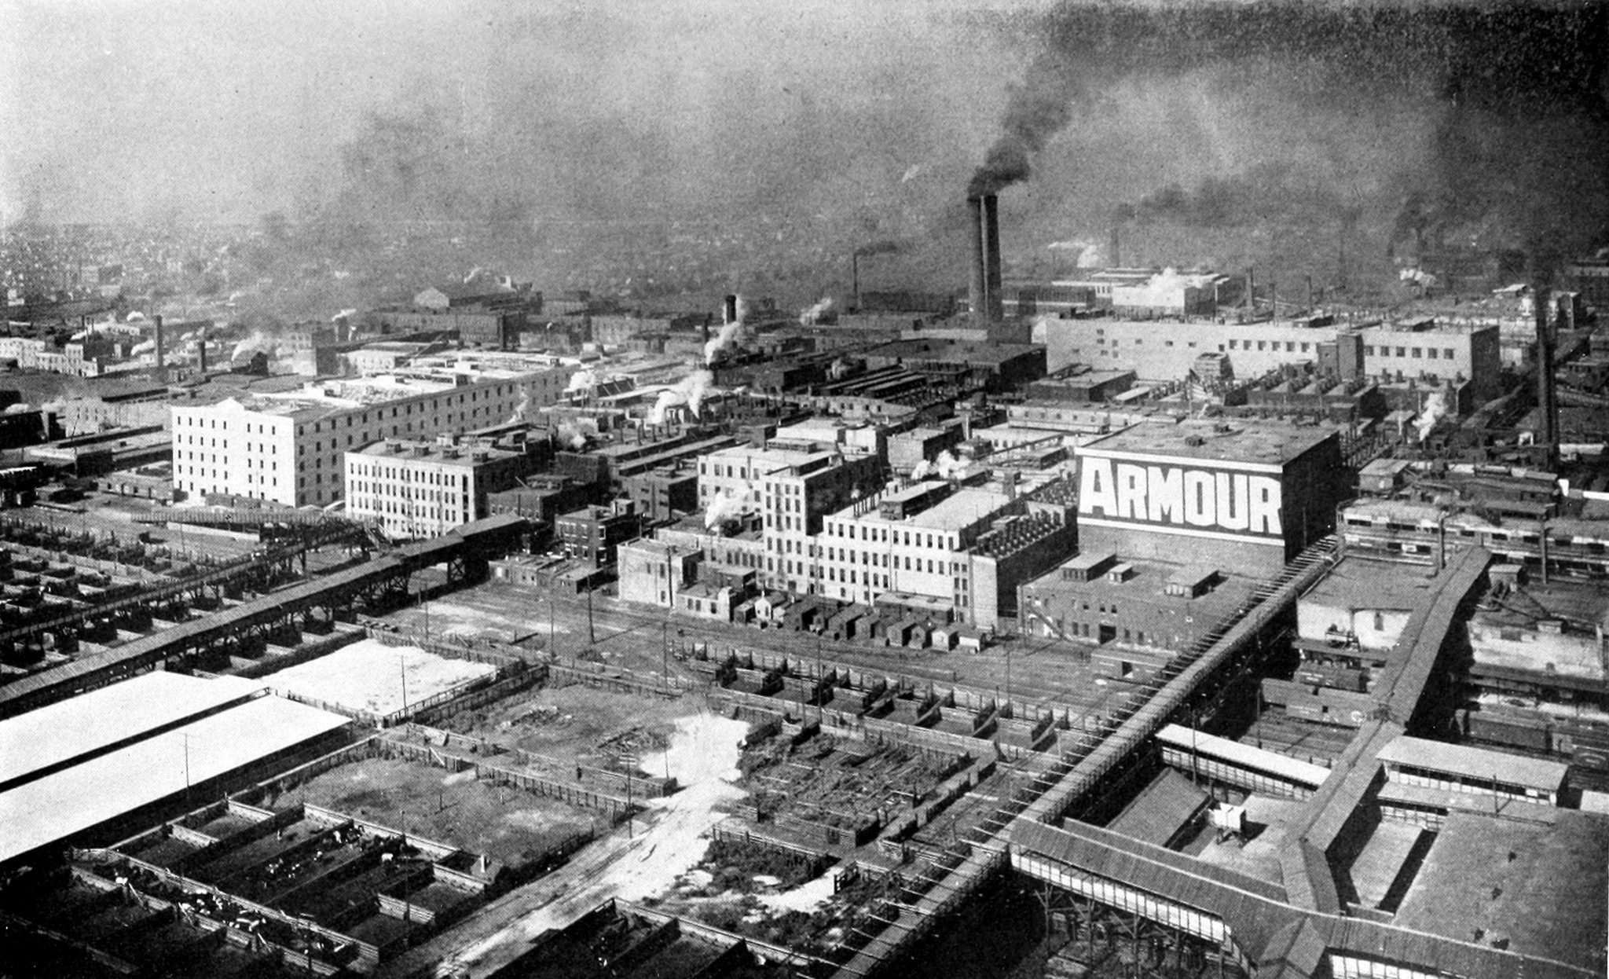
Industrial Areas Foundation
Never do for others what they can do for themselves.
Notes:
Community organizing: bringing together community members to address shared concerns or goals and in the process developing the civic capacity of everyday people to lead in public life.
organizing is the intervention to addressing inequities of power and resources to advance health equity.
one of the striking things about our society is the lack of opportunities for public relationships, but we as doctors are public figures.
relational organizing builds public relationships that are grounded in our private lives.
We are intimately connected to our patients private lives and through organizing we can provide an opportunity for public engagement
But we must do this standing alongside our community, arm in arm, not prescribing solutions as an all knowing expert.

Slide 8
Relational organizing
Multi-sectoral alliances of community institutions
Faith
Labor
Civic non-profit
Healthcare
Notes:
Relational organizing builds multi-sectorial partnerships grounded in relationship to address community needs

Slide 9
Relational organizing
IAF organizations serve to:
Build strong institutions that are relational, action-oriented and reflective
Develop local leadership to build capacity to solve public issues by taking action in public life
Serve as a vehicle for member groups to act with sufficient power for the common good

Slide 10
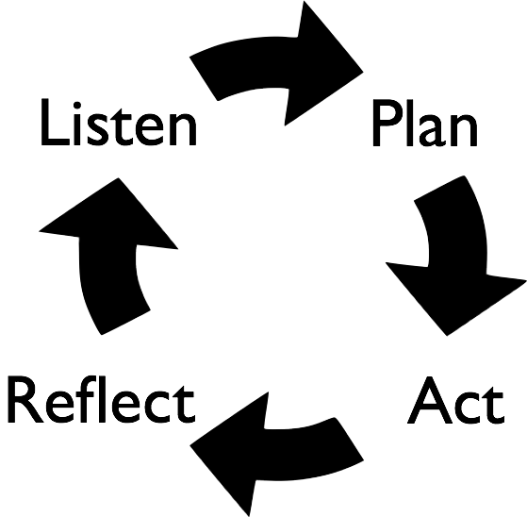
The Organizing Cycle
Notes:
Sick/Safe leave example
Listen: relational meeting,
Plan: take a problem and cut an issue
Act: make tangible change
Reflect: plan for next time

Slide 11
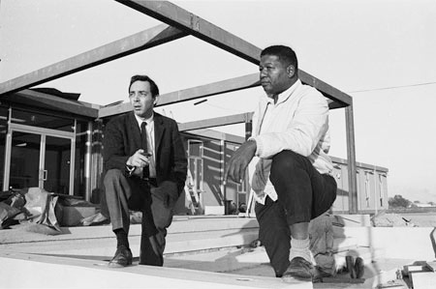
Back to the Future
“Our concept of health is to make social change, to build the
institutions that make social change, and to keep it going.
We call it Community Health Action”
-H Jack Geiger, MD
Notes:
3:04-4:55
https://vimeo.com/9307557

Slide 12
Notes:
LM

Slide 13
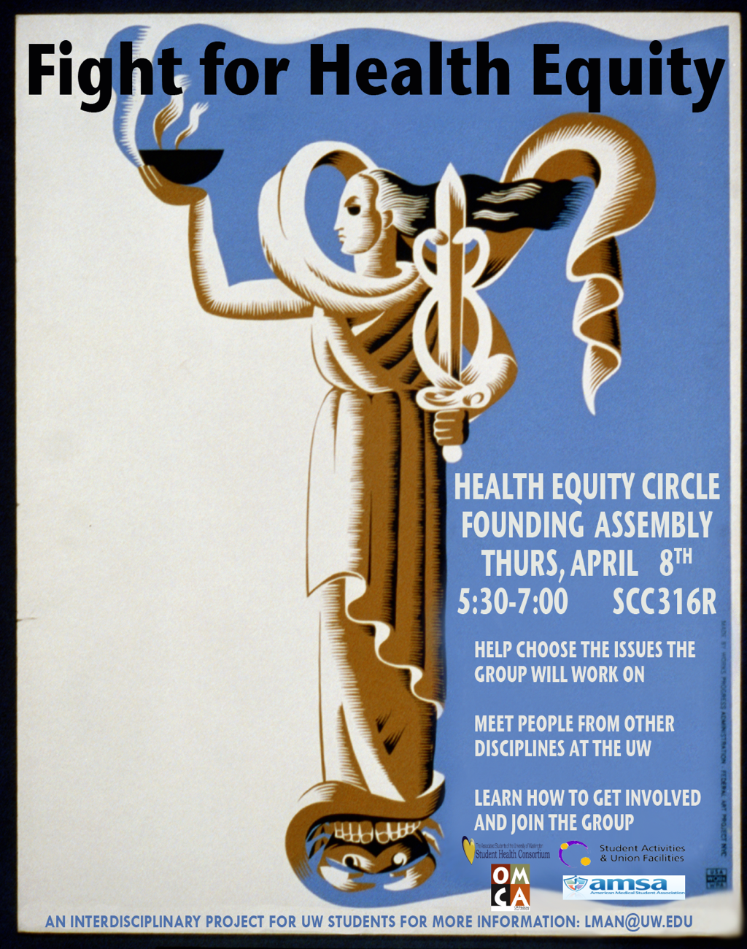
Health Equity Organizing
Interprofessional education
Health Equity Circle
Residency Training
Clinic Based Organizing
Notes:
A pathway for clinicians to work for structural change already exists and requires dramatic expansion.
It involves clinician participation in the work of voluntary nongovernmental organizations (NGOs) and multiprofessional collaborations.

Slide 14
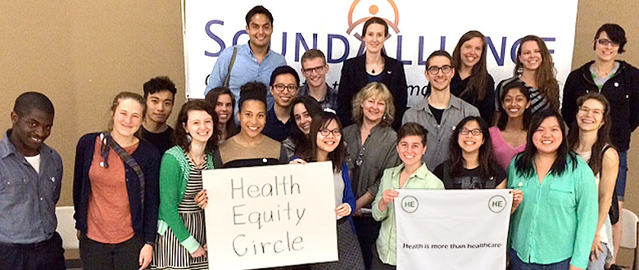
Health Equity Circle
Regional network in WA and OR
- Seattle: UW
- Spokane: WSU/EWU/UW
- Portland: OHSU/PSU, NUNM
- Bozeman, MT (in development)
Notes:
This has been the most rewarding work of my medical career and whatever skills I have with people I owe to this training in community organizing. I can say with absolute certainty that it has made me a better doctor and on several occasions saved a patients life.

Slide 15
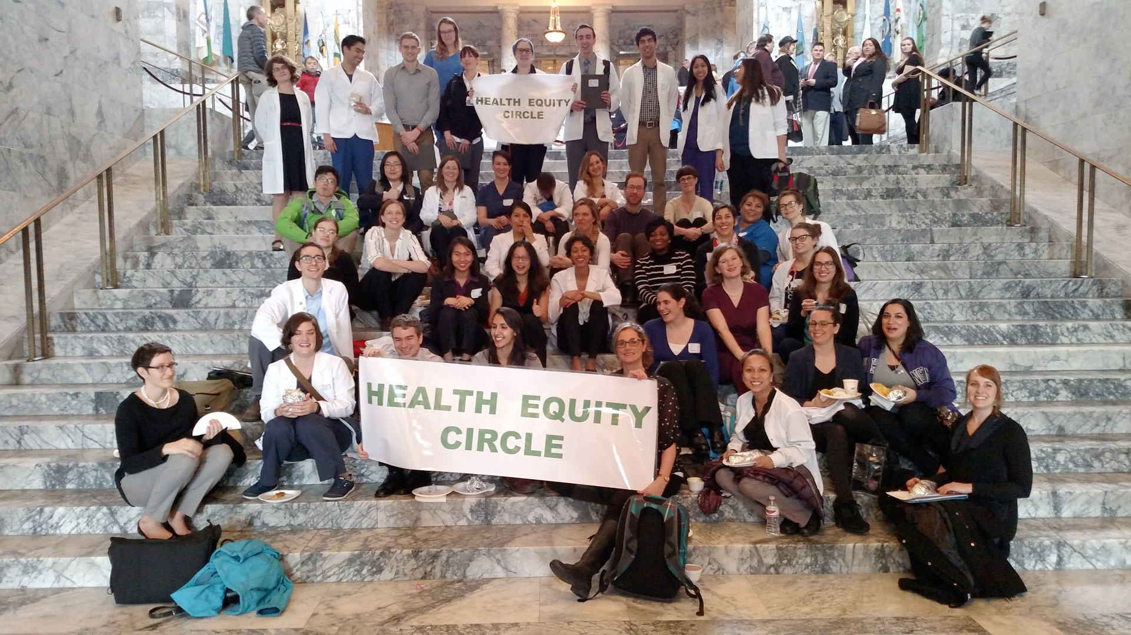
Health Equity Circle
- Tent City: Passed Seattle ordinance legalizing encampments on city property
- Students for Anti-racist UWSOM
- Advocates for the Underserved Lobby day
Notes:
This has been the most rewarding work of my medical career and whatever skills I have with people I owe to this training in community organizing. I can say with absolute certainty that it has made me a better doctor and on several occasions saved a patients life.

Slide 16
Residency Education
Swedish FM Cherry Hill
- 2nd year residents
- social medicine curriculum
OHSU FM
- 4th year population health
curriculum
- longitudinal Health Equity curriculum (in development)
Residency curriculum deeper than student training and based on weeklong IAF regional/national training

Slide 17
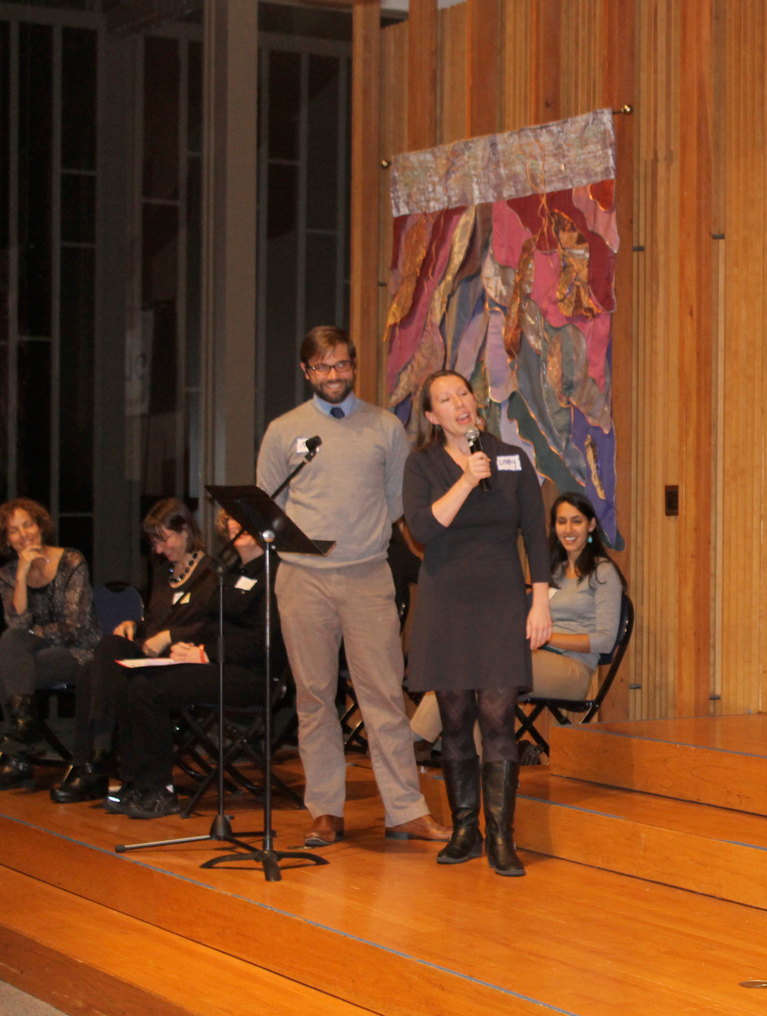
Residency Education
Best Starts for Kids
-$392 million for King County
Most comprehensive approach
to early childhood development
in the nation

Slide 18
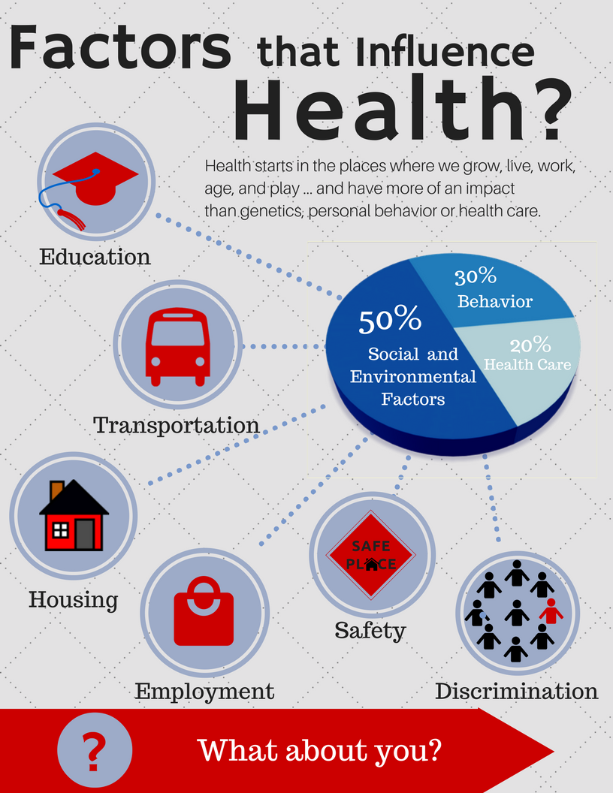
Clinic-Based Community Organizing
Modern update of
Community Health Action,
bringing together IAF organizing and FQHCs
Partnership between:
- HEC
- IAF-NW
- OHSU: Richmond/Scappoose
- Swedish: County Doc,
Carolyn Downs
- Sea Mar Seattle

Slide 19
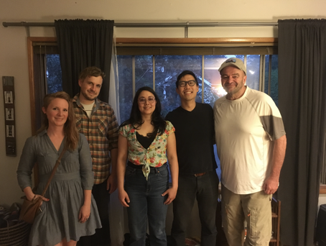
Clinic-Based Community Organizing
Organizer in the clinic
Clinic staff member
IAF-NW Trained
IAF-NW organizer cohort
Organizer role
In clinic referral system
Identify patient and staff leaders
Develop Core team
Identify community SDOH priorities
Develop community partnerships
Support SDOH campaigns
Notes:
Leanne, jacob, Treva, Brian, Mark

Slide 20
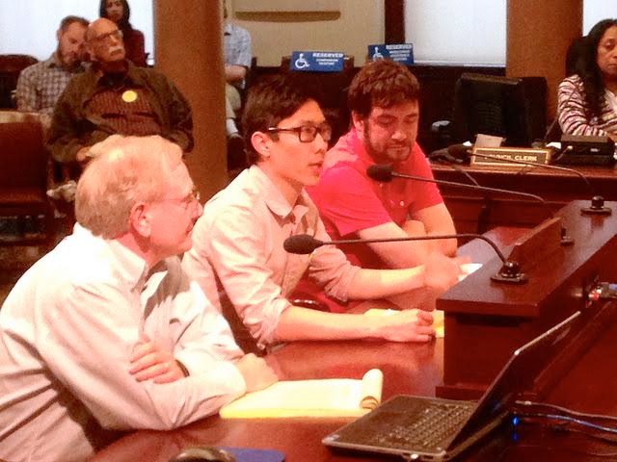
Early results
- Tax Increment financing: $67 million in funding for affordable housing
“It opened my eyes
to see the strengths
and assets our patients
have”
“HEAL-R prescribed me a purpose”
Notes:
Dr Park giving testimony to city council on inclusionary zoning
three layer cake: campaign win, institutional orientation (more relational), individual (leadership development)

Slide 21
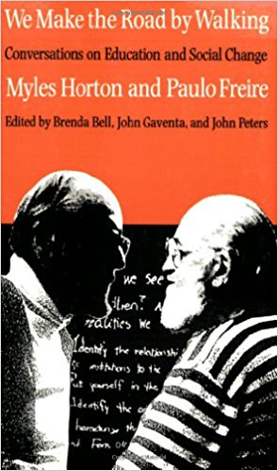
Next steps
Half time organizer Sea Mar clinics
- Full time organizers
OHSU FM
WSU: BAVI Health
UW and WSU: Health Equity
curriculum
Developing research plan on
organizing as an intervention on SDoH
Notes:
Dr Park giving testimony to city council on inclusionary zoning

Slide 22
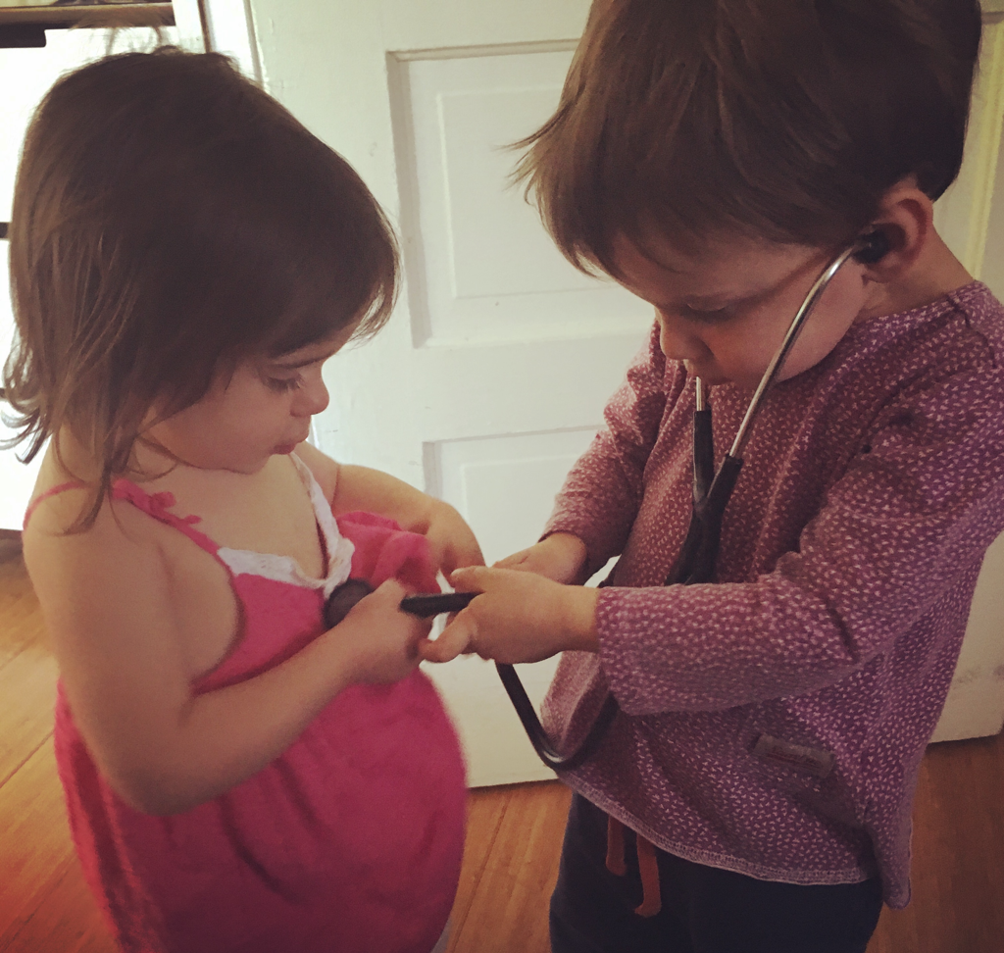
Thank you!
Questions?
nathankittle@gmail
lmanriquez@gmail
brianjhpark@gmail

